Slide 1
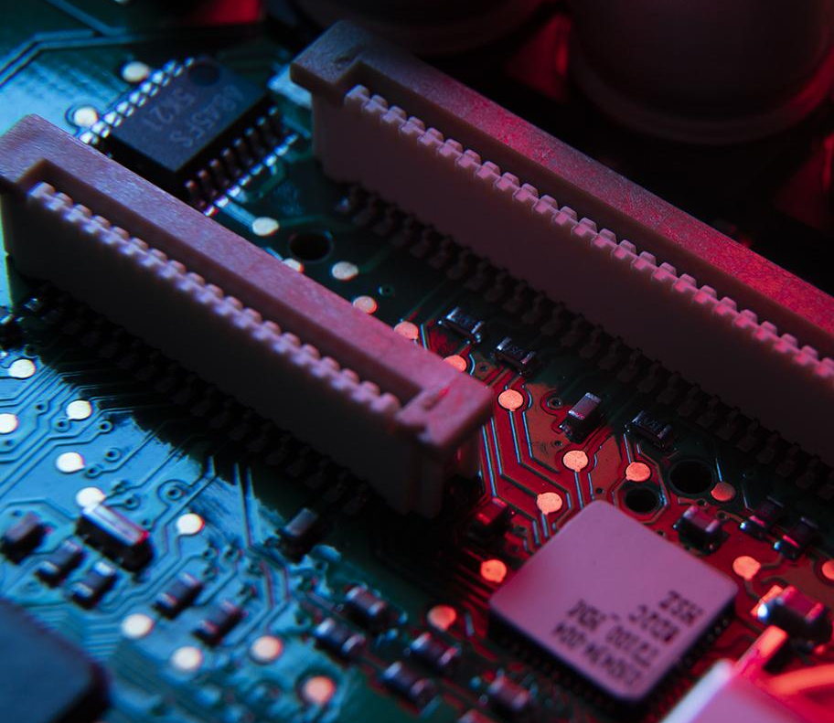
Hardware Design in VHDL for MNG (Measurement Network Gateway)
Mohammad Mahdi Mohammadi - 42719

Slide 2
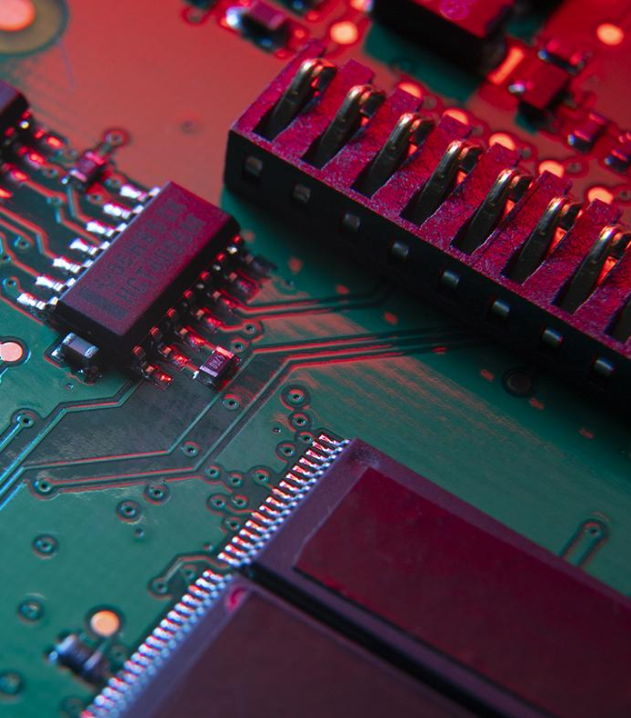
Table of contents
1. Sensor Measurement for MNG

Slide 3
Hardware Design using VHDL
Sensors to be measured:
Temperature Sensor
ADC0
ADC1
Push Buttons
Switches
For measurement of the above sensors, different modules are written in VHDL language in Vivado Design Suite and the end all the modules are integrated into one single IP (Intellectual Property).

Slide 4
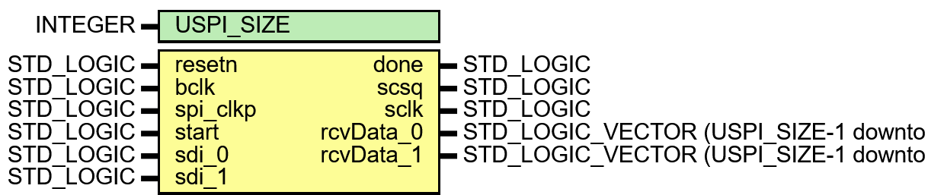
ADC0 and ADC1 Measurement
ADC0 and ADC1 represent two analog measurement channels in the system.
Their values are acquired through a dual-lane SPI-based ADC interface.
The measured results are stored as raw digital counts for further use in software and monitoring.
The following figure shows the input and output definition of the module.
generic
outputs
inputs

Slide 5
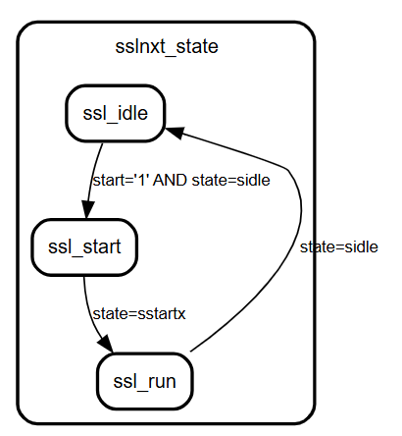
ADC0 and ADC1 Measurement
The architecture contains two FSMs: one control FSM for start/stop handling, and one SPI FSM for the bit-level ADC data acquisition.
ssl_idle: wait for a new start command and signal ready.
ssl_start: generate the internal start pulse for SPI transfer.
ssl_run: wait until the SPI FSM finishes and returns to idle.

Slide 6
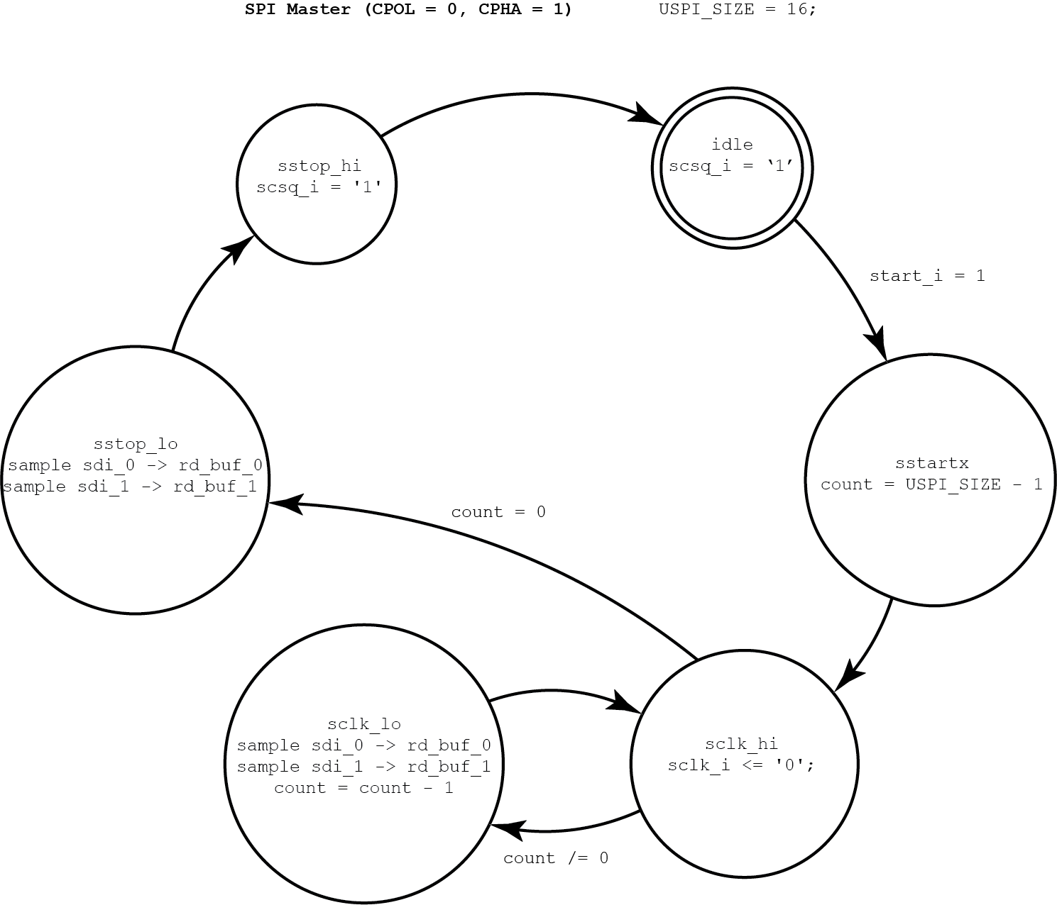
ADC0 and ADC1 Measurement
Dual-lane SPI interface for simultaneous acquisition of ADC0 and ADC1.
Reads two serial data streams, sdi_0 and sdi_1, in parallel.
Stores the results in rcvData_0 and rcvData_1.
Uses FSM-based control for SPI acquisition.
Provides raw ADC values to the system.

Slide 7
Hardware Design using VHDL
Temperature Measurement
For temperature measurement MAX31865 Pmod module is used.
It is a resistance-to-digital converter.
Resistance is converted into digital value by MAX31865.
Digital value is communicated with the zedboard through SPI.
Key features
Temperature measurement configuration
2-wire method (In MNG this method Is used)
3-wire method
4-wire method
15bit ADC resolution
21ms (max) Conversion Time
SPI communication

Slide 8
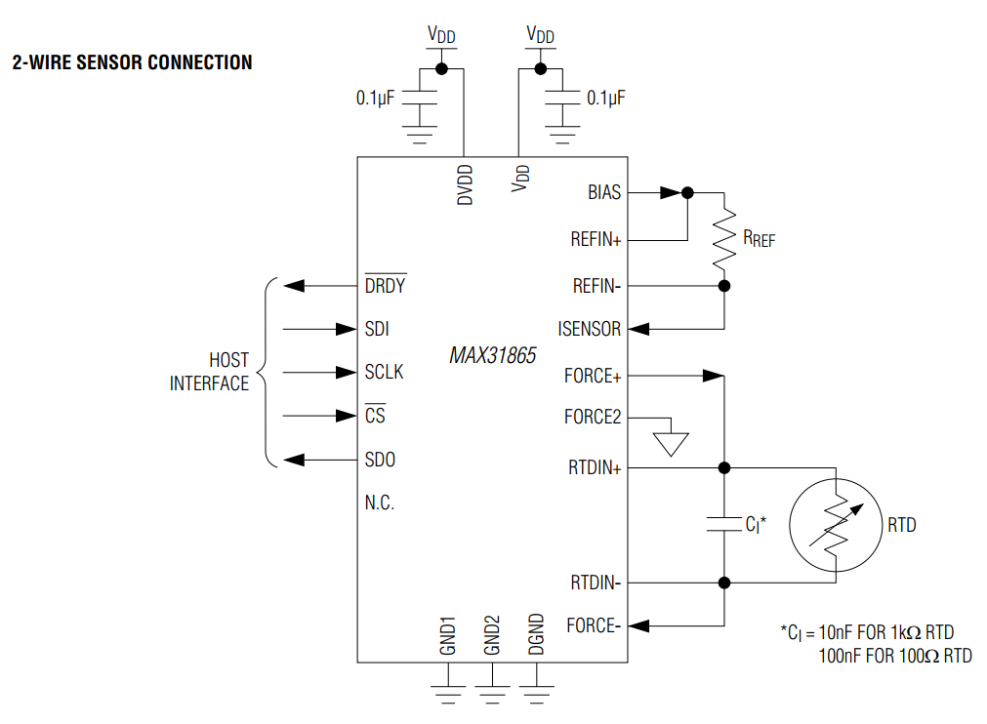
Hardware Design using VHDL
MAX31865 connection with Zedboard
Since we are using 2-wire connection, the MAX31865 should be connected to the zedboard as per the following circuit diagram.
Communication with the host is done through the SPI signals SDI, SDO, SCLK, and CS.
The DRDY pin can be used to indicate that a new conversion result is ready.
Based on MAX31865 datasheet, it support

Slide 9
Hardware Design using VHDL
MAX31865 VHDL Implementation
CPOL defines the idle level of the SPI clock
CPHA defines whether data is sampled on the first or second clock edge.
CPOL and CPHA together define the SPI mode.
Four SPI modes exist: 0, 1, 2, and 3.
MAX31865 supports mode 1 and mode 3.
Our implementation uses CPOL = 1 and CPHA = 1, which is SPI mode 3.

Slide 10
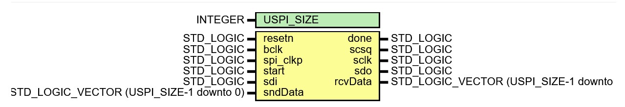
Hardware Design using VHDL
MAX31865 VHDL Implementation
CPOL defines the idle level of the SPI clock
CPHA defines whether data is sampled on the first or second clock edge.
CPOL and CPHA together define the SPI mode.
Four SPI modes exist: 0, 1, 2, and 3.
MAX31865 supports mode 1 and mode 3.
Our implementation uses CPOL = 1 and CPHA = 1, which is SPI mode 3.
MAX31865 VHDL Module Implementation
generic
Inputs
outputs

Slide 11
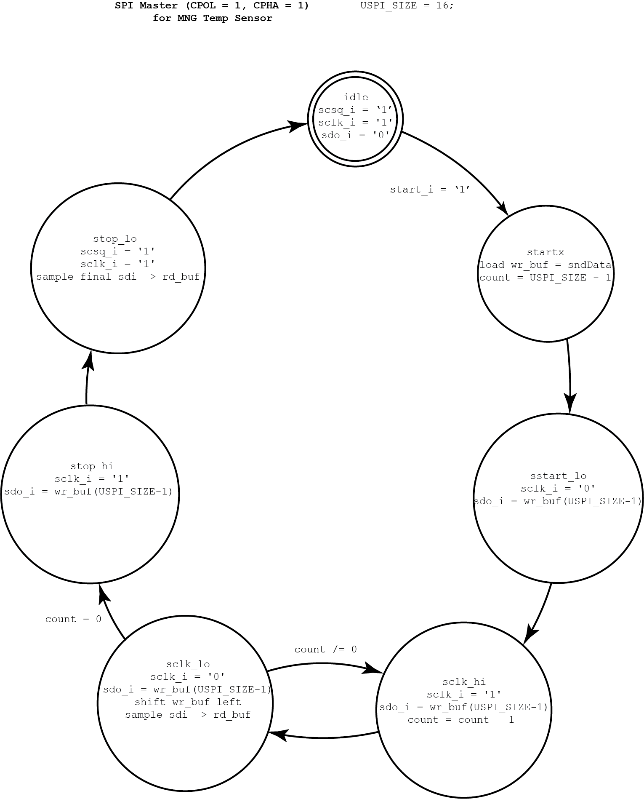
MAX31865 VHDL Implementation
sidle → CS inactive, clock idle high, wait for start.
sstartx → load transmit word and initialize counter.
sstart_lo → drive clock low and output first bit.
sclk_hi → clock high, keep data stable, decrement counter.
sclk_lo → clock low, shift transmit data, sample input data.
stop_hi → final high clock phase.
stop_lo → release CS and sample final bit.

Slide 12
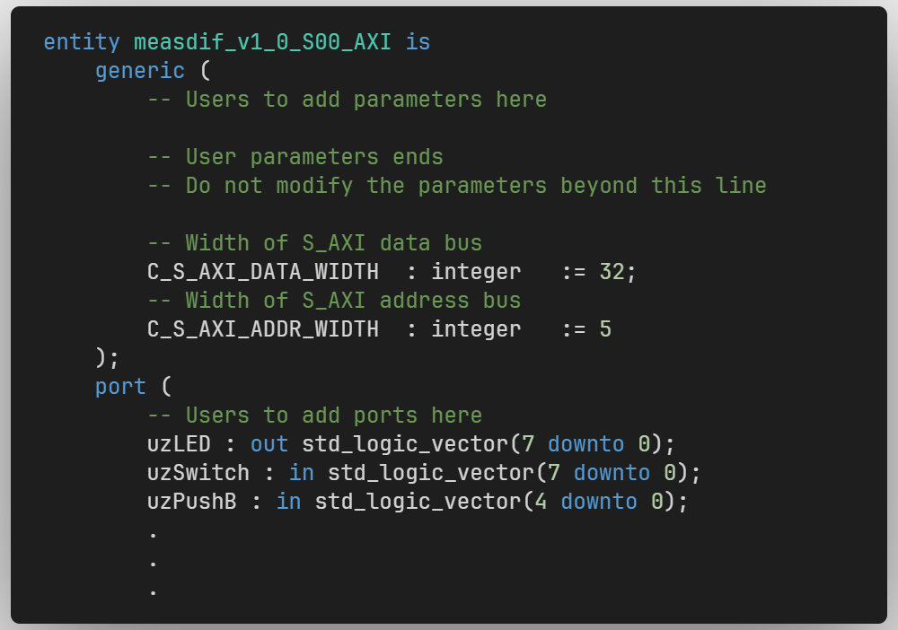
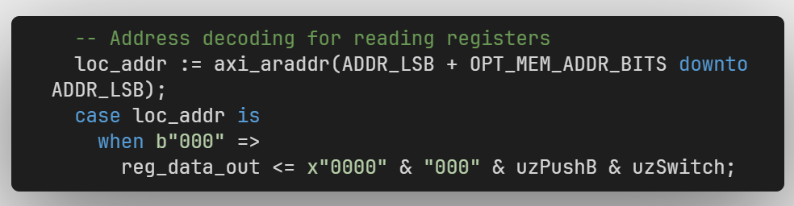
Push Buttons and Switches
The ZedBoard switches and pushbuttons are also integrated into the AXI interface as digital input measurements.
In the project, switches are sid_switches = 4 and pushbuttons are sid_pushb = 5.
The inputs are connected through uzSwitch(7 downto 0) and uzPushB(4 downto 0).
AXI read address 000 returns both input groups in one register.
The lower 8 bits contain the switch values, and the next 5 bits contain the pushbutton values.

Slide 13
Push Buttons and Switches
The ZedBoard switches and pushbuttons are also integrated into the AXI interface as digital input measurements.
In the project, switches are sid_switches = 4 and pushbuttons are sid_pushb = 5.
The inputs are connected through uzSwitch(7 downto 0) and uzPushB(4 downto 0).
AXI read address 000 returns both input groups in one register.
The lower 8 bits contain the switch values, and the next 5 bits contain the pushbutton values.

Slide 14
Sensors Integration with AXI Interface
Temperature
A write to AXI register 001 triggers max_start and sends slv_reg1(15 downto 0) to the MAX31865.
The SPI pins are connected through umCSn, umSCLK, umMOSI, and umMISO.
The status register at address 001 returns max_drdyn and max_done.
address 010 returns the received temperature data in MAX_Data.
--component instantiation
max_pmod: sph1pol1
GENERIC MAP ( USPI_SIZE => 16)
PORT MAP ( resetn => S_AXI_ARESETN,
bclk => S_AXI_ACLK,
spi_clkp => spi_transmp,
start => max_start,
done => max_done,
scsq => umCSn,
sclk => umSCLK,
sdo => umMOSI,
sdi => umMISO,
sndData => slv_reg1(15 downto 0),
rcvData => MAX_Data);
.
.
--writing to registers.
when b"001" =>
max_start <= '1';
for byte_index in 0 to (C_S_AXI_DATA_WIDTH/8-1) loop
if ( S_AXI_WSTRB(byte_index) = '1' ) then
-- Respective byte enables are asserted as per write strobes
-- slave registor 1

Slide 15
Sensors Integration with AXI Interface
Temperature
The status register at address 001 returns max_drdyn and max_done.
address 010 returns the received temperature data in MAX_Data.
process (slv_reg3, slv_reg6, slv_reg7, axi_araddr, S_AXI_ARESETN, slv_reg_rden,
uzSwitch, uzPushB, max_done, max_drdyn, MAX_Data, done_adc, ADC_Data)
variable loc_addr :std_logic_vector(OPT_MEM_ADDR_BITS downto 0);
begin
-- Address decoding for reading registers
loc_addr := axi_araddr(ADDR_LSB + OPT_MEM_ADDR_BITS downto ADDR_LSB);
case loc_addr is
when b"000" =>
reg_data_out <= x"0000" & "000" & uzPushB & uzSwitch;
when b"001" =>
reg_data_out <= x"0000000" & "00" & max_drdyn & max_done;
when b"010" =>
reg_data_out <= x"0000" & MAX_Data;

Slide 16
Sensors Integration with AXI Interface
ADC0 & ADC1
ADC_Data(15 downto 0) contains ADC0, while ADC_Data(31 downto 16) contains ADC1.
adcRX : adc2lane
GENERIC MAP ( USPI_SIZE => 16 )
PORT MAP ( resetn => S_AXI_ARESETN,
bclk => S_AXI_ACLK,
spi_clkp => spiclk_p,
start => start_adc,
done => done_adc,
scsq => uAD1csq,
sclk => uAD1Sclk,
sdi_0 => usdiAD_0,
sdi_1 => usdiAD_1,
rcvData_0 => ADC_Data(15 downto 0),
rcvData_1 => ADC_Data(31 downto 16));

Slide 17
Sensors Integration with AXI Interface
ADC0 & ADC1
A write to AXI register 100 generates start_adc and starts the ADC acquisition.
The ADC interface uses uAD1csq, uAD1Sclk, usdiAD_0, and usdiAD_1.
The done flag is read from AXI address 100, and the ADC result is read from address 101.
ADC_Data(15 downto 0) contains ADC0, while ADC_Data(31 downto 16) contains ADC1.
--writing to the registers.
when b"100" =>
start_adc <= '1';
for byte_index in 0 to (C_S_AXI_DATA_WIDTH/8-1) loop
if ( S_AXI_WSTRB(byte_index) = '1' ) then
-- Respective byte enables are asserted as per write strobes
-- slave registor 4
when b"100" =>
reg_data_out <= x"0000000" & "000" & done_adc;
when b"101" =>
reg_data_out <= ADC_Data;

